Slide 1
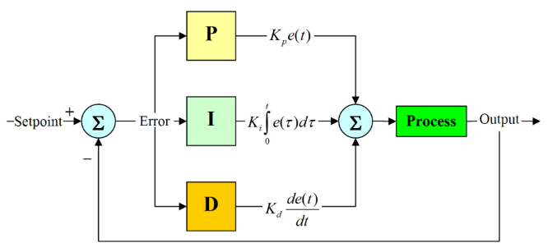
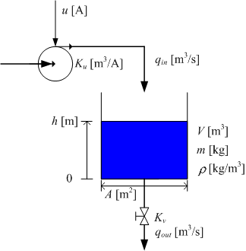
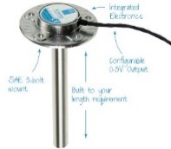
INTRODUCTION TO CONTROL SYSTEMS: CONTROL SYSTEM DESIGN
3
1
DESIGN
CONTROLLER
DEVELOP PROCESS MATHEMATICAL MODEL
Disturbance
Controlled Signal
Manipulated Variable
Error
+
+
Actual Output
Set-point or Reference input
+
Controller
Actuator
+
+
Process
-
2
SELECT SENSOR
Sensor
Notes:
Identify
(a) What you want to control (the process or plant)
(b) How you can control it (via actuators)
(c) How you can measure it (via sensors)
2. Formulate a mathematical model, in either
(a) The time domain (via state-space models and di↵erential equations)
(b) The frequency domain (via transfer functions)
3. Linearize around a desired operating point, if necessary
4. Design a controller for the linear system
5. Optimize its parameters to meet desired control objectives

